Slide 1
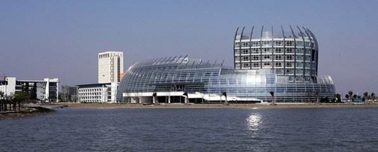
Maximum Channel Access Probability Based on Post-Disaster Ground Terminal Distribution Density
Xingxing Hu
College of Information Science and Technology
Donghua University, Shanghai, China
2181295@mail.dhu.edu.cn

Slide 2
CONTENTS
Background
Problem & challenges
Contributions
System Model
Problem formulation & analysis
Simulation analysis
Conclusion
2

Slide 3
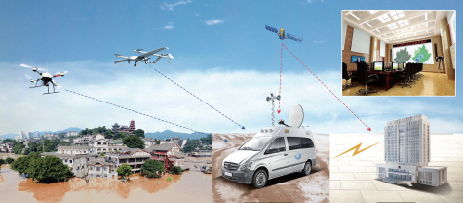
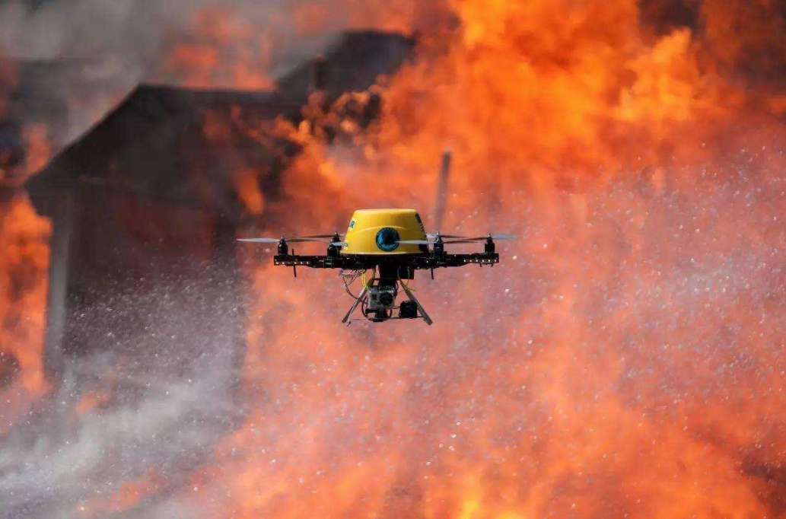
Background
After the disaster, the ground communication infrastructure will be severely damaged, which will bring great troubles to rescue work.
Due to its lightness, compactness, flexible layout and high probability of line-of-sight transmission, UAVs have been widely used in post-disaster rescue work.
3

Slide 4
Problem & Challenge
The impact levels in the whole post-disaster area maybe different. We should use a suitable distribution to model the location of ground terminal (GT) according to GTs’ distribution densities.
UAV’s speed should be adjusted according to GTs’ distribution densities.
A dynamic channel resource allocation should be made to alleviate channel resource competition and further improve channel access probability.
4

Slide 5
Contributions
A more suitable Thomas cluster process (TCP) [1]is used to model the locations of GTs who are scattered around hotspots , and each cluster has different GT distribution density.
We propose an UAV adaptive speed cruise model based on GT distribution density among the whole disaster area.
An efficient channel allocation method is proposed to alleviate resource competition.
5

Slide 6
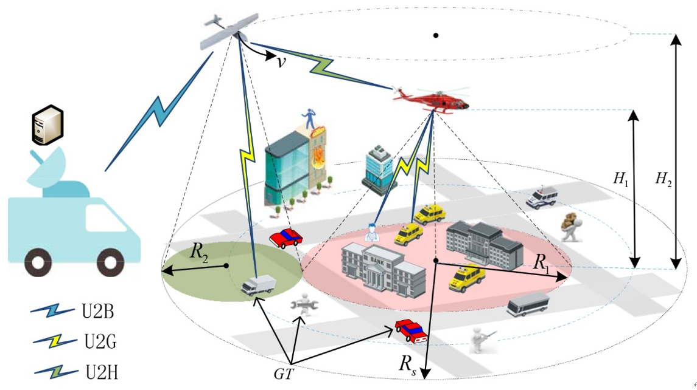
System Model -- Network Structure
Referencing paper [2], we deploy a hovering flying helicopter (HFH) to cover the worst heavily hit area. The cruise flying UAV circles around HFH. The coverage of HFH and UAV is neither overlap nor gap.
UAV and HFH can communicate with each other to exchange command center’s orders, information and so on.
There are many GTs in the ground of post-disaster area and all GTs are equipped with battery powered transceivers. GTs located in different area could communicate with corresponding aircrafts.
Fig 1, System Model
6

Slide 7
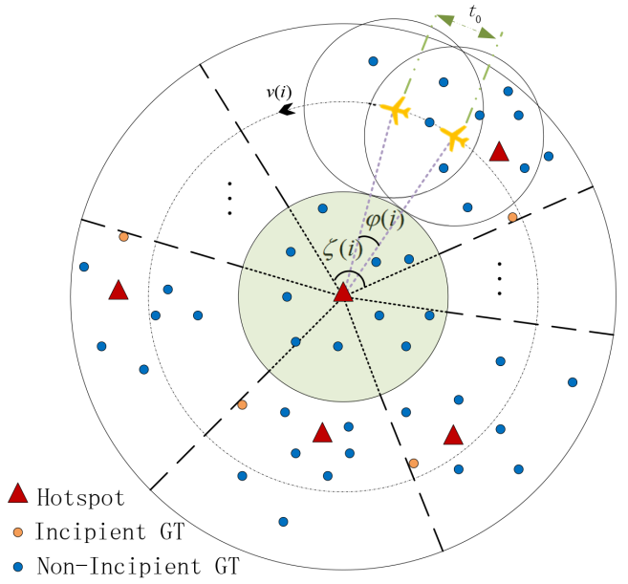
System Model -- GT Distribution
The locations of hotspots, such as densely populated areas, are modeled by an independent Poisson point process (PPP) .
The locations of all GTs who are scattered around hotspots are modeled by TCP.
Fig 2, GT Distribution Diagram
7

Slide 8
System Model -- Channel Model
The Air-to-Ground channel[3] which is dominated by Line-of-Sight link is adopted in our paper.
Channel power gain
Small scale fading
Distance from GT to the horizontal projection point of its corresponding aircraft
Flying height of HFH or UAV
8

Slide 9
System Model -- Cruise Model
We introduce the channel access delay (seconds)[2] which indicates the minimum time for establishing a complete communication link with the UAV.
As is shown is Fig 2, within the time , an overlapping area will appear. Only GTs in this overlapping area can establish complete communication links with the UAV. The area of overlapping area is
When UAV flies over subregion , the speed of UAV is and it should satisfy .

Slide 10
Problem formulation
First, channel access probability is defined as the probability that a random GT located in post-disaster area can successfully establish full communication link with aircraft.
Objective function is:
and our goal is to obtain the maximum system channel access probability by optimizing the flight speed of UAV .

Slide 11
Problem formulation
Channel SNR threshold probability[4]:
It is defined as the probability that a random GT satisfies the signal-to-noise ratio (SNR) condition when it picks up the detection signal sent by its corresponding aircraft.
Aircraft’s transmission power
SNR threshold
Noise power

Slide 12
Problem formulation
Channel allocation ratio :
It denotes the percentage of channels obtained by HFH when the UAV flies over subregion .
Average number of GTs under HFH coverage area
GT distribution density of cluster
Overlapping area within when UAV flies over the subregion

Slide 13
Problem formulation
Other related parameters:
represent the probabilities that GT is within the HFH or UAV coverage area when the UAV flies over the subregion , respectively.
central angle of subregion
Amount of channel
represent the probabilities that a GT located in the coverage of HFH or UAV can obtain a channel when UAV flies over subregion , respectively.

Slide 14
Problem formulation
Channel access probability of subregion :
Probability that random GT under HFH coverage can connect to HFH
Probability that random GT under UAV coverage can connect to UAV

Slide 15
Main results
It is easy to prove that the constraints are all convex.
By restraining the SNR and the flying speed of the UAV, we can prove that the objective function is convex when following constraints are satisfied.
and we can find a unique by binary search algorithm.

Slide 16
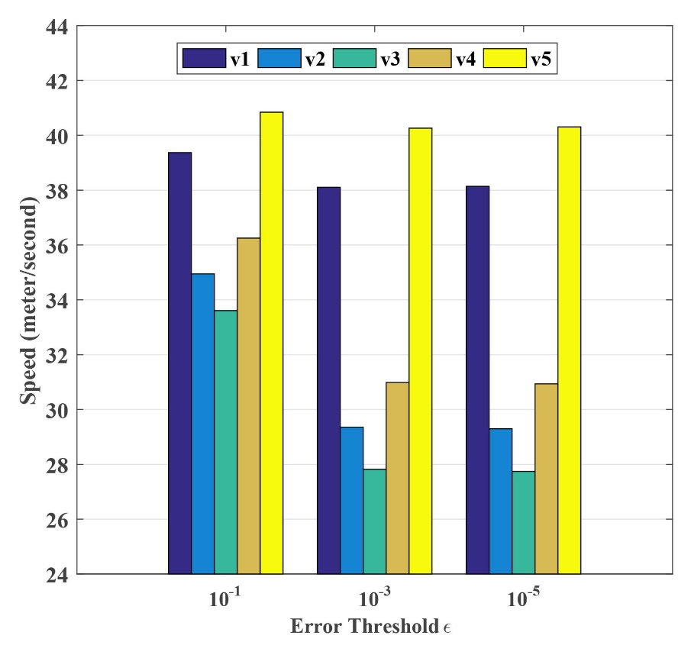
Simulation analysis
The optimal speed of the UAV under different errors
16

Slide 17
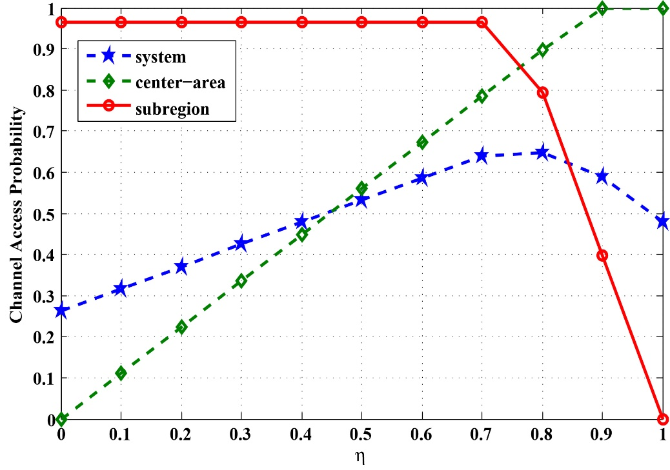
Simulation analysis
Comparison of system channel access probability under different channel allocation ratio
17

Slide 18
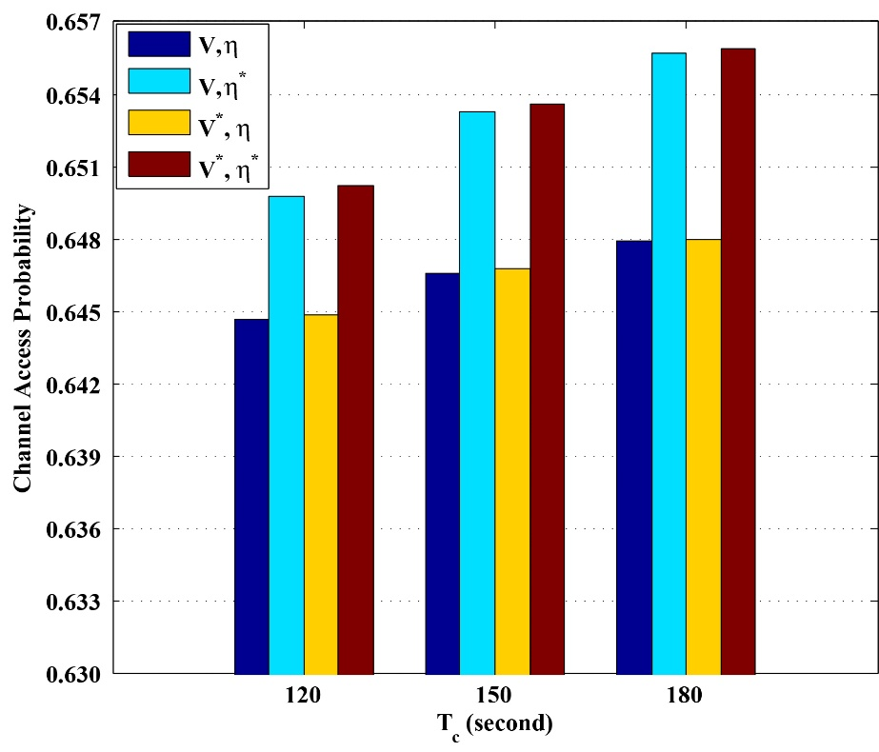
Simulation analysis
Channel access probability under different optimization conditions
18

Slide 19
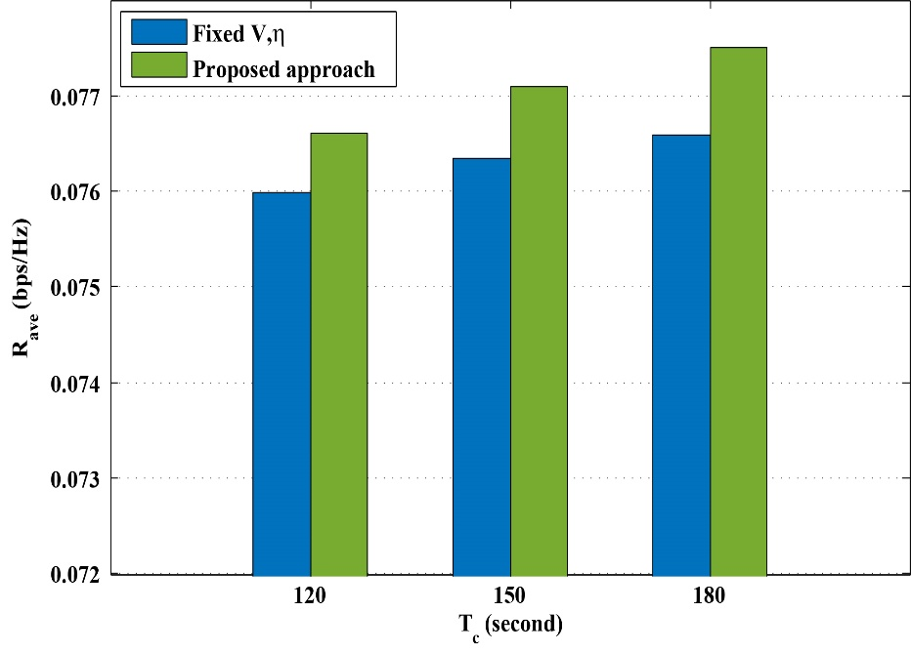
Simulation analysis
System achievable rate under different cruise cycles
19

Slide 20
Conclusions
First, channel access probability can be improved by adopting a dynamic channel allocation and optimizing the UAV speed of each subregion.
Second, compared with constant UAV speed or channel allocation, the simulation results reveal that the proposed method performances well in channel access probability and achievable rate.
20

Slide 21
Future work
In future research, we will pay more attention to the cooperative flight of multiple UAVs, including the research of FANET's communication routing protocol, the trajectory of multiple UAVs and energy optimization.
Our convex condition is a little harsh, and we need to generalize it to a more general form to satisfy more application scenarios.

Slide 22
Reference
[1] X. Wang and M. C. Gursoy, "Coverage Analysis for Energy-Harvesting UAV-Assisted mmWave Cellular Networks," in IEEE Journal on Selected Areas in Communications, vol. 37, no. 12, pp. 2832-2850, Dec. 2019, doi: 10.1109/JSAC.2019.2947929.
[2] S. Zhang and J. Liu, "Analysis and Optimization of Multiple Unmanned Aerial Vehicle-Assisted Communications in Post-Disaster Areas," in IEEE Transactions on Vehicular Technology, vol. 67, no. 12, pp. 12049-12060, Dec. 2018, doi: 10.1109/TVT.2018.2871614.
[3] Y. Zeng and R. Zhang, "Energy-Efficient UAV Communication With Trajectory Optimization," in IEEE Transactions on Wireless Communications, vol. 16, no. 6, pp. 3747-3760, June 2017, doi: 10.1109/TWC.2017.2688328.
[4] L. Zhou, Z. Yang, S. Zhou and W. Zhang, "Coverage Probability Analysis of UAV Cellular Networks in Urban Environments," 2018 IEEE International Conference on Communications Workshops (ICC Workshops), Kansas City, MO, 2018, pp. 1-6, doi: 10.1109/ICCW.2018.8403633.

Slide 23
Thanks!
College of Information Science and Technology
Donghua University, Shanghai, China

